Slide 1
Unit 203: Electrical installations technology
Socket circuits

Slide 2
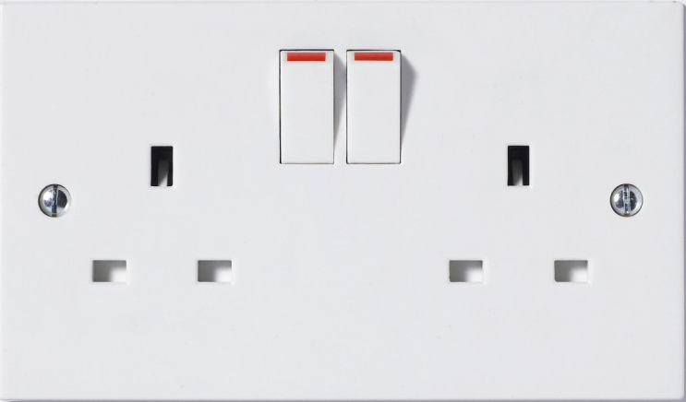
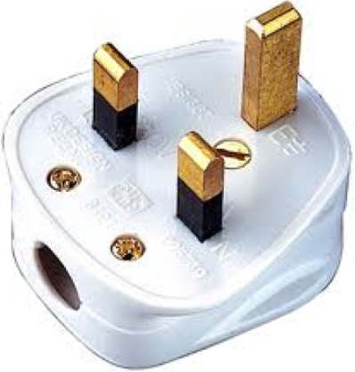
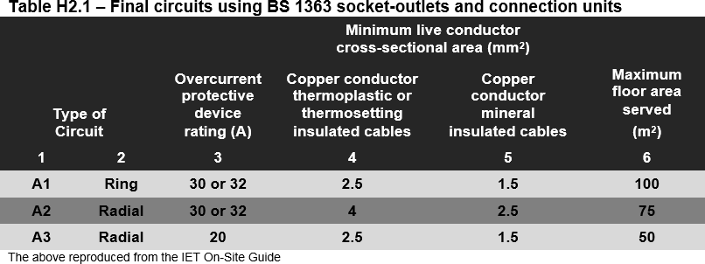
Socket circuits

Slide 3
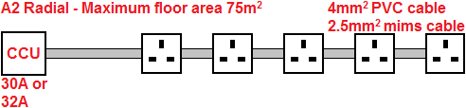

Socket circuits
Radial final circuit

Slide 4
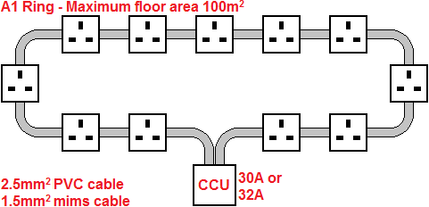
Socket circuits
Ring final circuit

Slide 5
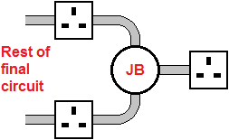
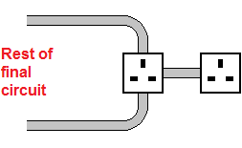
Socket circuits
Spurs

Slide 6
Unit 203: Electrical installations technology
The End

